Slide 1
Pre-lab Questions

Slide 2
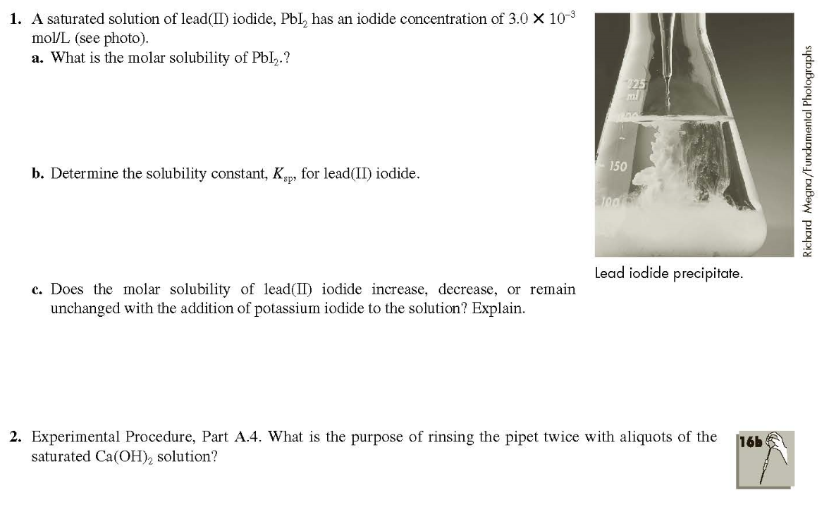
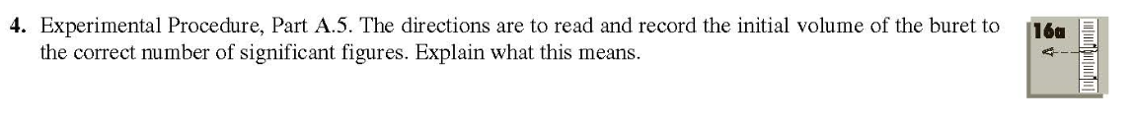
(3 points)
(3 points)
(4 points)

Slide 3
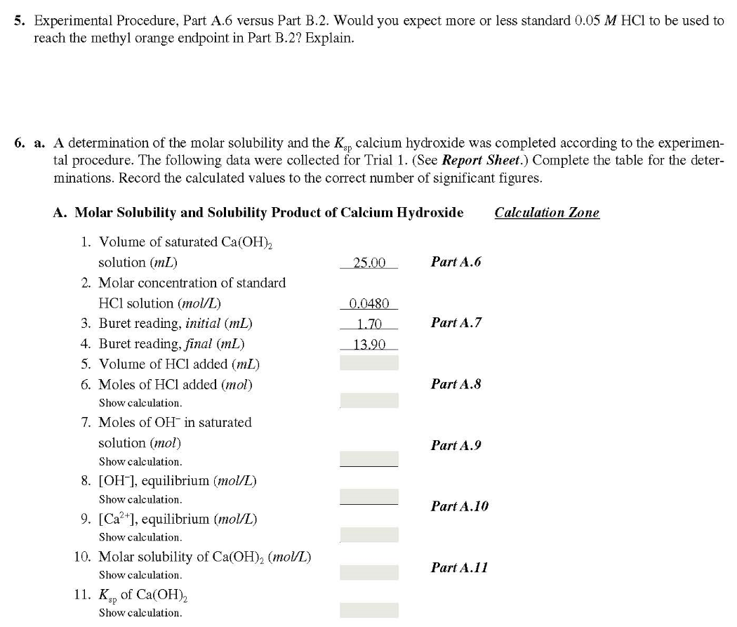
(3 points)
(7 points)

Slide 4
Laboratory Reports
Use the format shown in manual(page 25~27).
+ Discussion(Summary/Assessing the result/Conclusion) should be included here.

Slide 5
Post-lab Questions
(4 points each)

Slide 6
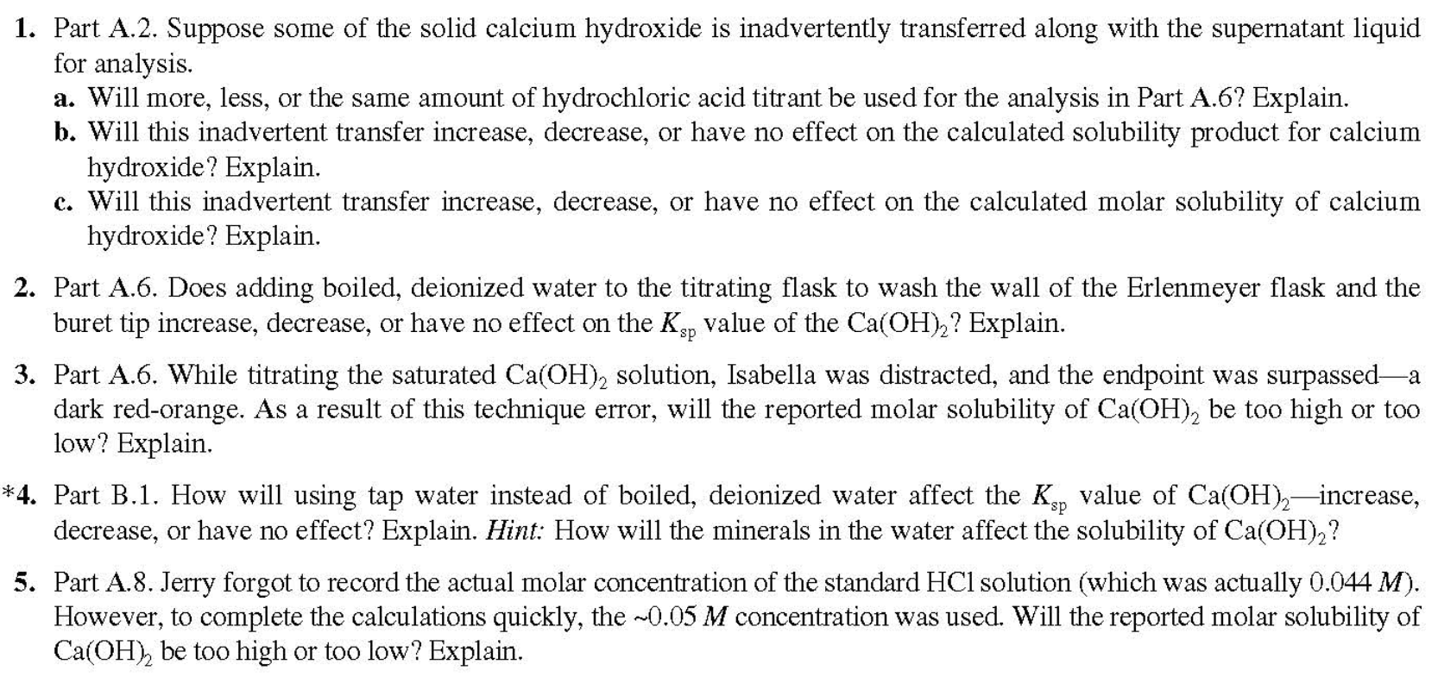

Slide 7
Textbook Content for Exp 9

Slide 8
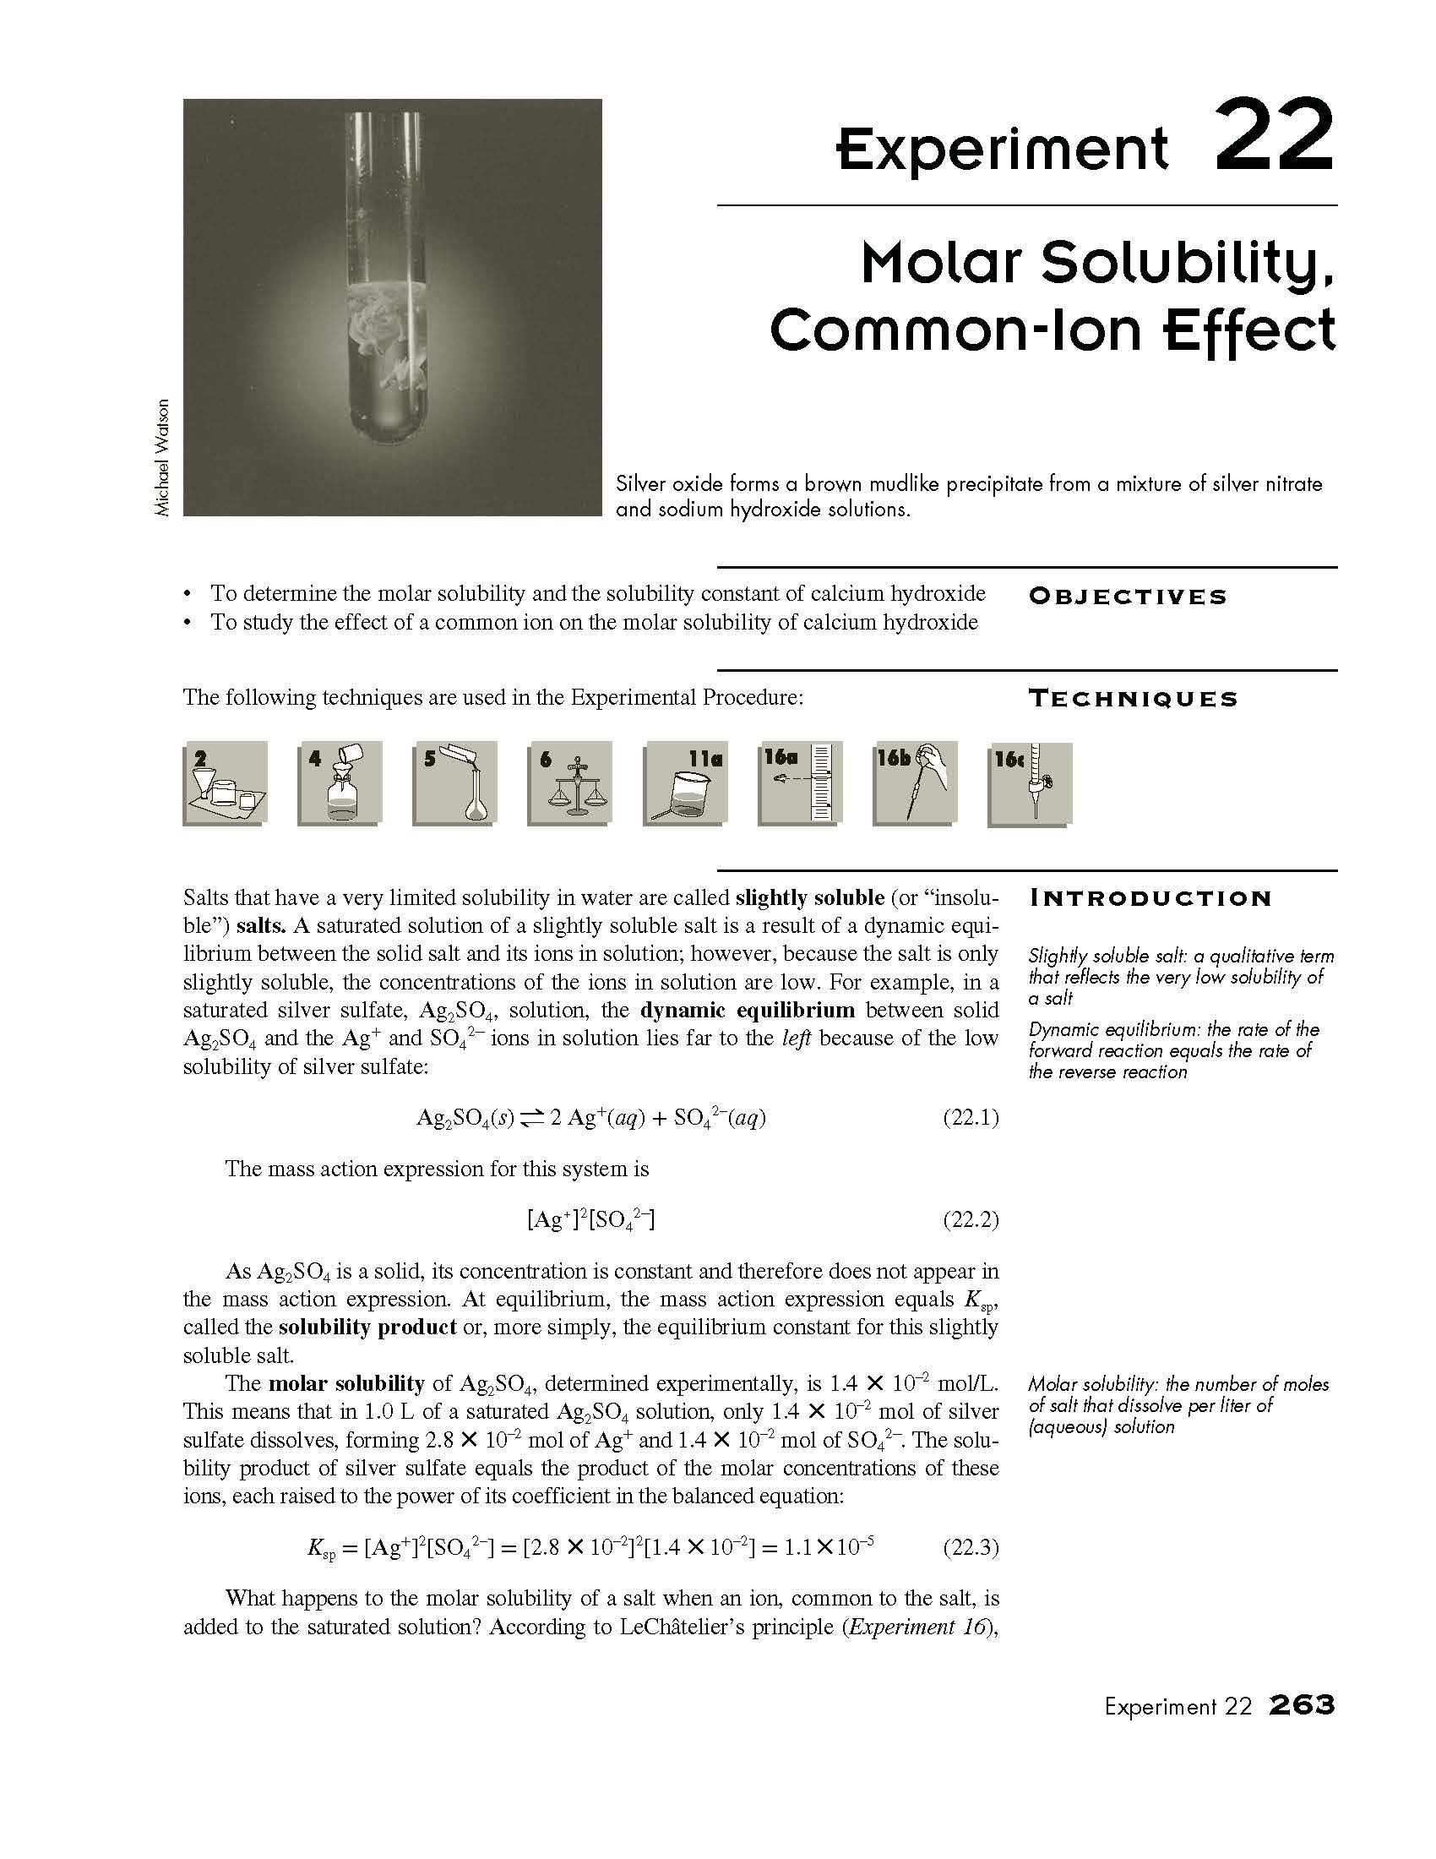
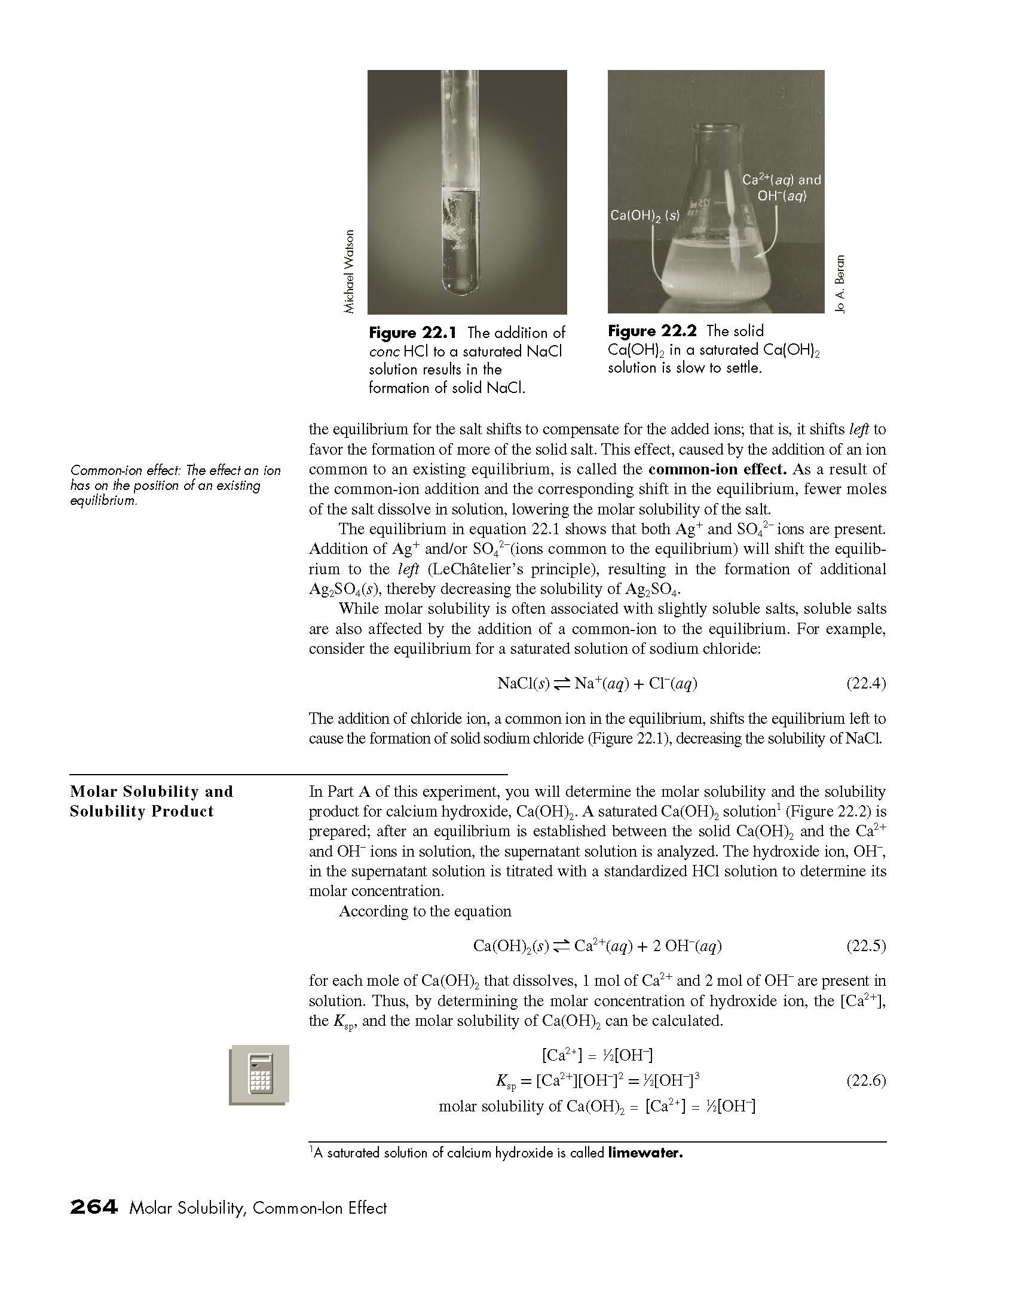

Slide 9
